Slide 1

Organizing Data on Personal Computer

Slide 2
Keep your Electronic Files Organized !!!

Slide 3
1.
Get Rid of Duplicate Files

Slide 4
Having Multiple Copies of the Same File is a Dangerous Game
Waste of storage space
Any changes won't sync between them
Leads to having different versions of the same document
Copies of files often arise when they are saved in different places. Don't do this. Instead, use shortcuts. Within the folder, right click and choose New > Shortcut and follow the wizard.

Slide 5
2.
Group Files in Folders and Sub-Folders

Slide 6
Now that you've gotten rid of the excess, you'll want to put the files that passed the test into Folders
Main/Large Folders
When you’re creating folders, think minimal.
For instance with Three Large folders:
Documents (Personal, Business, University, Family etc.)
Shared (Photos, etc.)
For things made by the rest of the world (MP3s, Movies, Software, etc.)

Slide 7
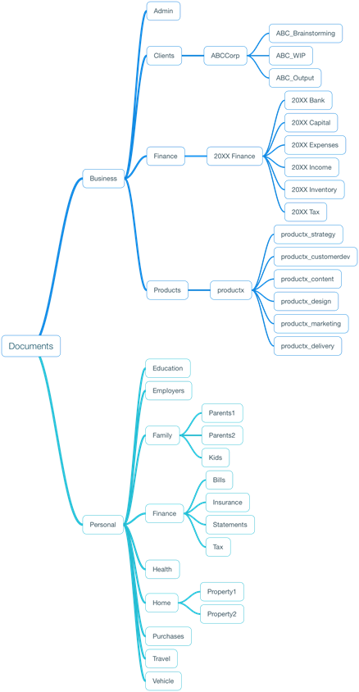
Keep your Desktop Clean!
Sub-Folders
Each folder will present its own particular set of requirements for further sub-organization.
You may decide to organize your music collection into sub-folders based on the artist’s name or
Digital photos might get organized based on the year/place they were taken.

Slide 8
3.
Folders/Files Naming Convention

Slide 9
Some operating systems (such as Unix) do not allow spaces in file or folder names, Avoid it!
Use underscores as a delimiter (e.g. Doe_John_Proposal.doc.)
Other characters such as / ? < > \ : * | " ^ are also prohibited in file or folder names under Windows.

Slide 10
Under Windows the maximum full path length for a file (e.g. the drive letter + folder names + file name) is 260 characters.
Use common abbreviations wherever possible, such as Jan for January or Corp for Corporation.
But, don't use un-common abbreviations. They might make sense at the time, but you'll probably forget what they mean.

Slide 11
Access Folders And Files Quickly
Use descriptive file names
Ensure your spelling and grammar are accurate so that they correctly appear in any searches
Folders or Files used a lot, rename with a ! or an AA at the beginning of the file name, to keep them on top

Slide 12
4.
General Tips to Remember

Slide 13
Use the Default Installation Folders for Programs
Installing applications elsewhere is confusing and unnecessary.
Get in the habit of using the "Save As" dialogue box to file your document as well as name it, putting it in the right place in the first place.

Slide 14
Keep the Downloads folder Clean!
You'll never need that old concert ticket PDF, so go ahead and delete the contents of your downloads folder
Personally, I have one folder on my desktop that says "Desktop." (Clever, I know:). Keeps my desktop clean.

Slide 15
Back up Your Files Regularly!!!
Always keep a backup to avoid Data Loss
Keep your backup on separate storage device
Drive can get damaged or ransomware can encrypt your data
Better keep a backup!!!

Slide 16
5.
Stick To Your Organization Plan

Slide 17
Even if you don't know where something is, you know where it should be
Once you come up with an organizational plan, make sure you stick to it. "Every new file you get, spend those extra few seconds to file it where it belongs. Otherwise, in just a month or two, you’ll be worse off than before — half your files will be organized and half will be disorganized — and you won’t know which is which."

